Slide 1

50.039 Theory and Practice of Deep Learning W11-S3 More on Reinforcement Learning
Matthieu De Mari

Slide 2
Introduction
What are actor-critic learning methods? And which problems do these approaches address?
What are more advanced problems in RL?
Markov states
Partially observable environment
SARSA
Non-stationary problems
What is Reinforcement Learning with Human Feedback (RLHF)?

Slide 3
Time for something a bit more advanced! (cont’d)
Definitely out-of-scope, but interesting nonetheless!

Slide 4
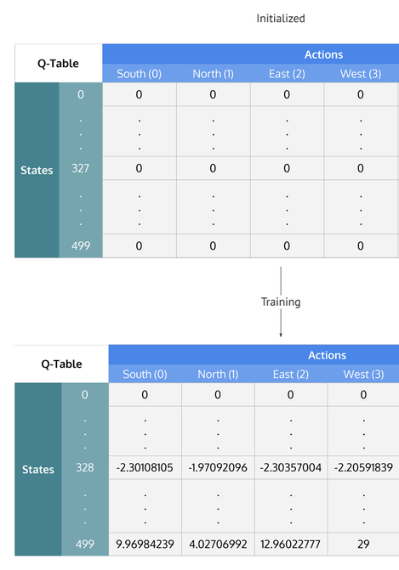
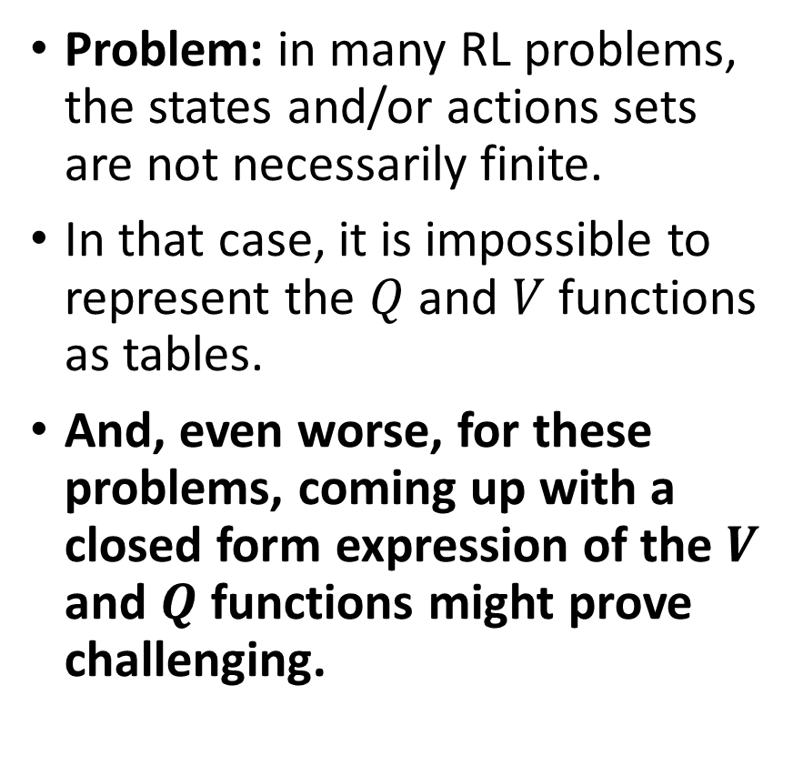
A representation problem
Problem: in many RL problems, the states and/or actions sets are not necessarily finite.
In that case, it is impossible to represent the $Q$ and $V$ functions as tables.
And, even worse, for these problems, coming up with a closed form expression of the $V$ and $Q$ functions might prove challenging.

Slide 5
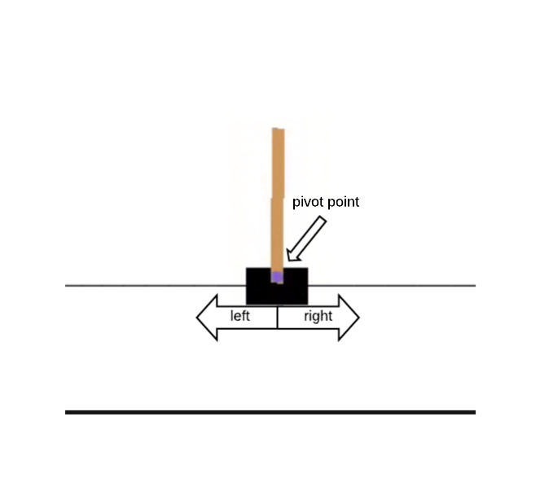
Toy example #3 (shown, but implementation out of the scope of this class)
Example: the cart-pole problem.
State: our current visualization of the cart (i.e. an image).
Actions: 2 of them, go left or go right at a fixed speed.
Reward: +1 for each unit of time where the cart does not leave the screen and the pole does not fall below a certain angle.
Next state generation: cart and pole both follow simple programmed rules of physics.

Slide 6
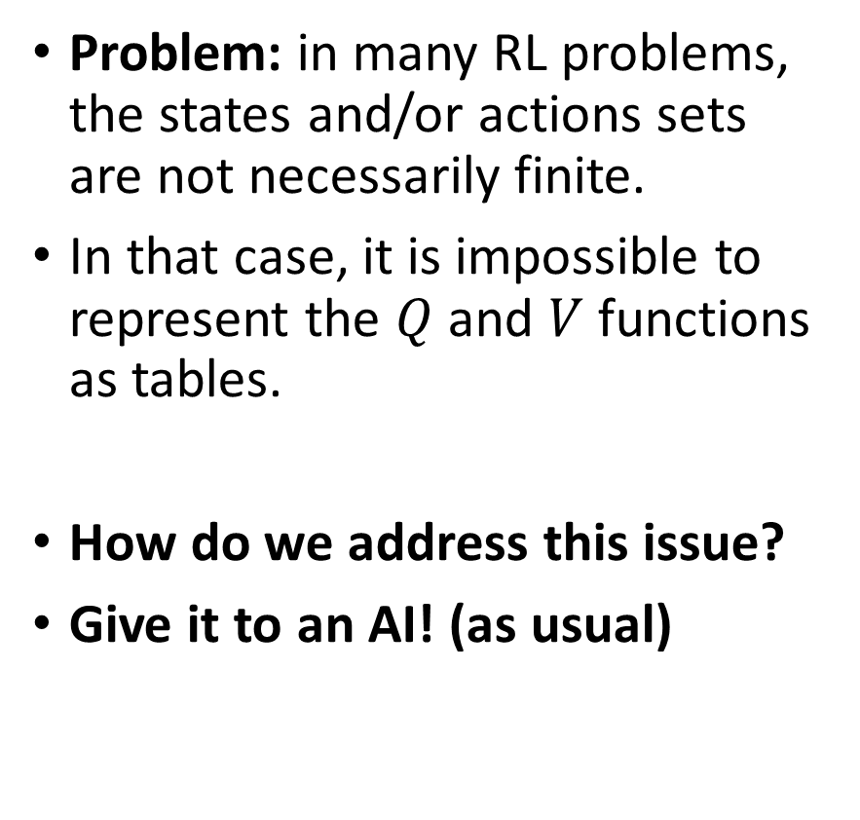
Toy example #3 (shown, but implementation out of the scope of this class)
Problem: in many RL problems, the states and/or actions sets are not necessarily finite.
In that case, it is impossible to represent the $Q$ and $V$ functions as tables.
How do we address this issue?
Give it to an AI! (as usual)

Slide 7
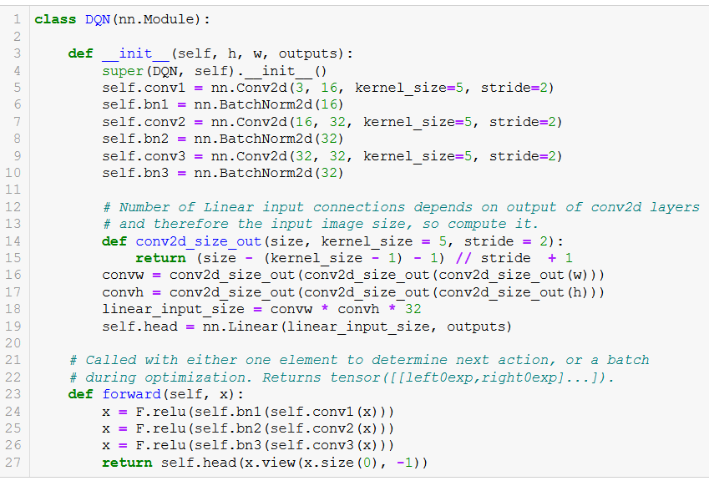
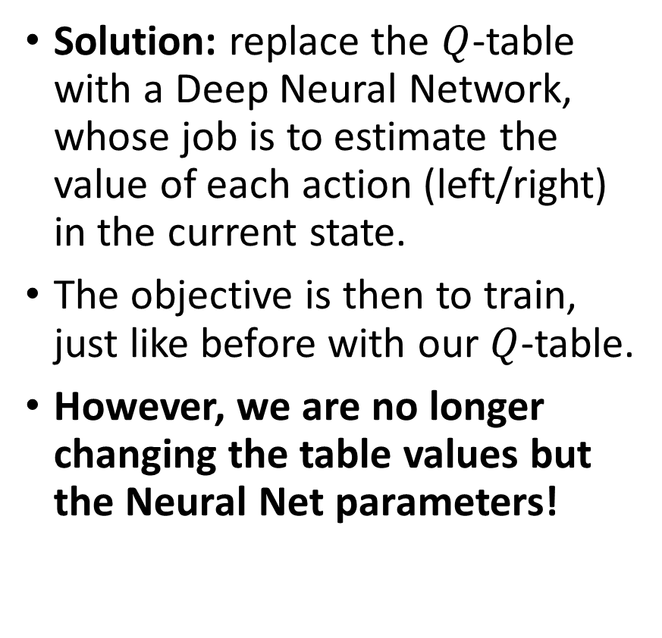
Toy example #3 (shown, but implementation out of the scope of this class)
Solution: replace the $Q$-table with a Deep Neural Network, whose job is to estimate the value of each action (left/right) in the current state.
The objective is then to train, just like before with our $Q$-table.
However, we are no longer changing the table values but the Neural Net parameters!

Slide 8
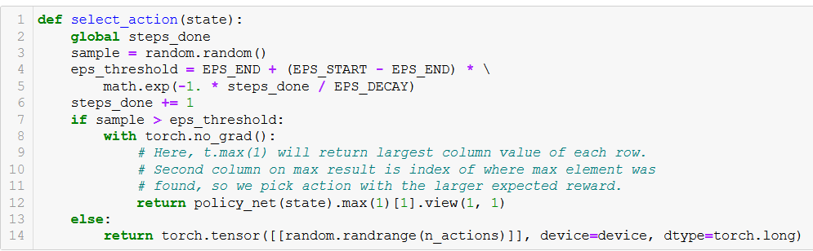
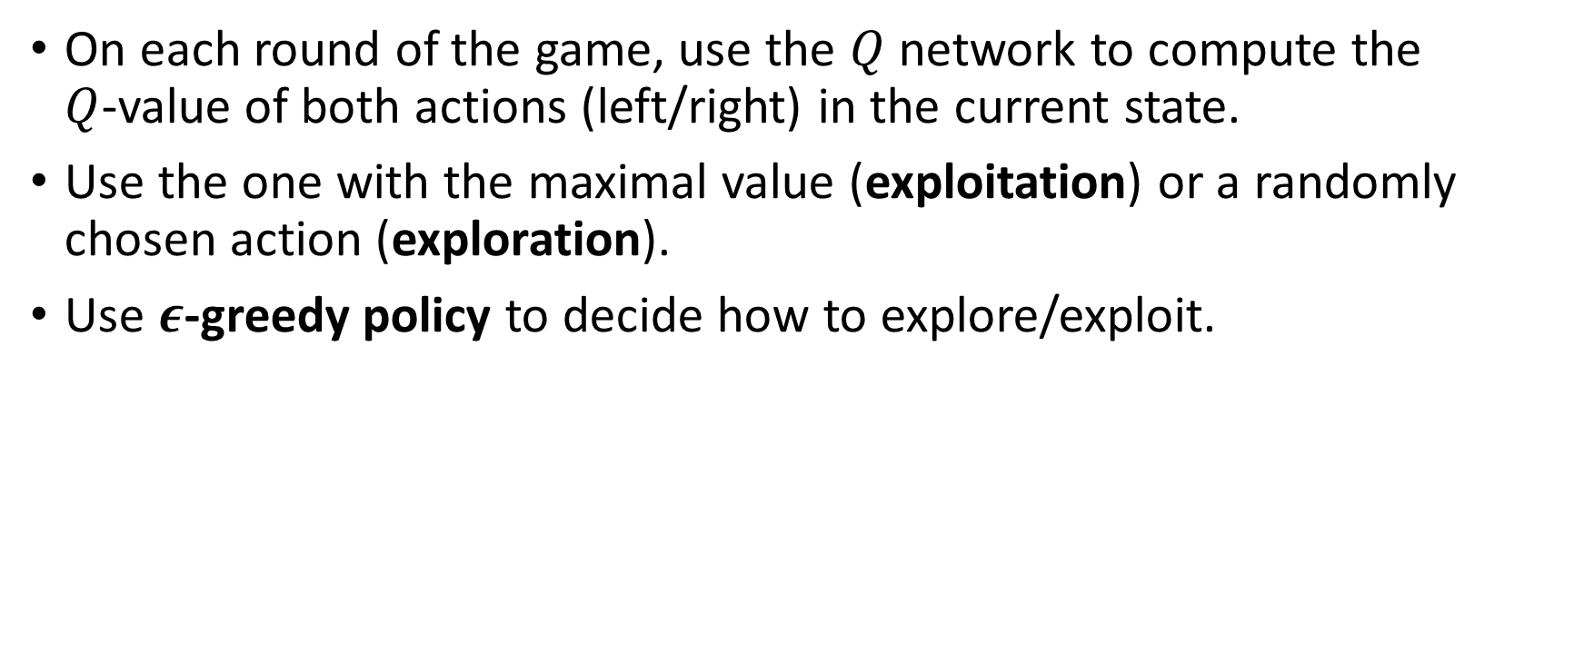
Toy example #3 (shown, but implementation out of the scope of this class)
On each round of the game, use the $Q$ network to compute the $Q$-value of both actions (left/right) in the current state.
Use the one with the maximal value (exploitation) or a randomly chosen action (exploration).
Use $ε$-greedy policy to decide how to explore/exploit.

Slide 9
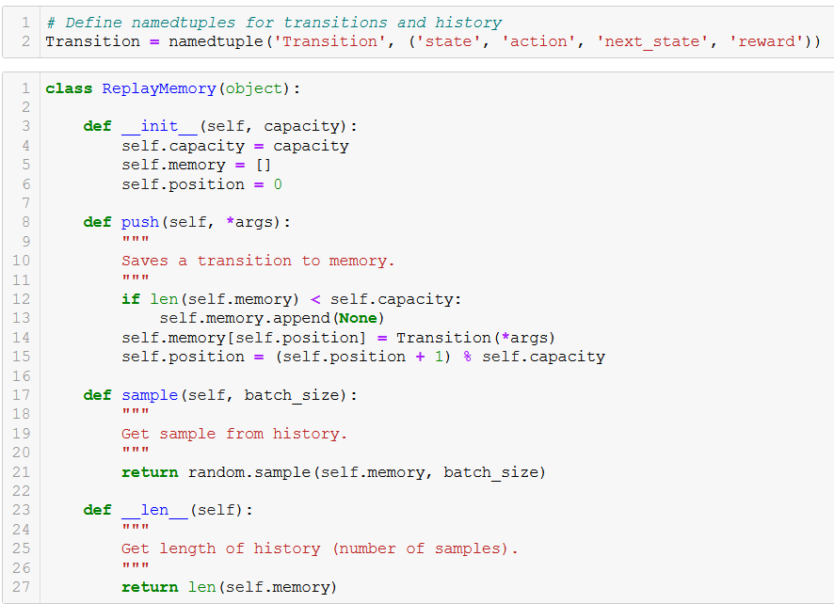
Toy example #3
To train this DNN, we need a dataset of some sort.
Do so by playing the game multiple times and keeping a history of the (state, action, rewards, next_state, done) tuples.
Here, done indicates that the game has ended (out of screen or low angle on pole).
Structure is roughly similar to our dataloaders?

Slide 10
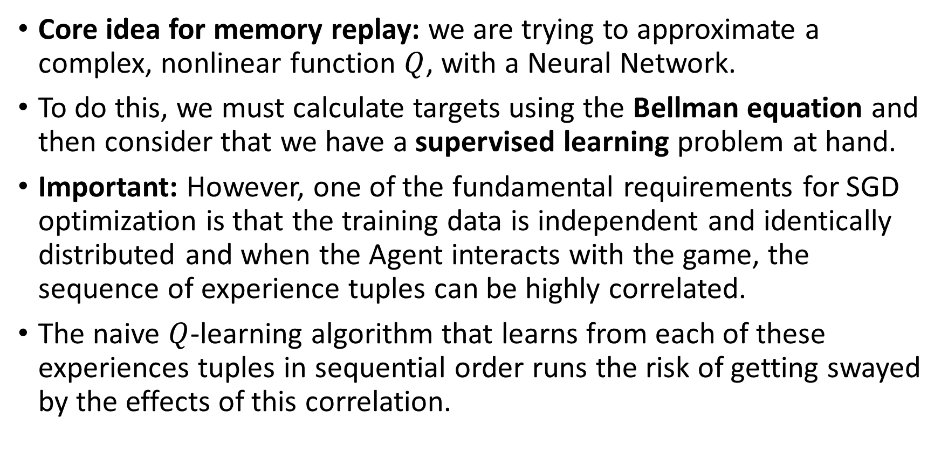
Toy example #3 (shown, but implementation out of the scope of this class)
Core idea for memory replay: we are trying to approximate a complex, nonlinear function $Q$, with a Neural Network.
To do this, we must calculate targets using the Bellman equation and then consider that we have a supervised learning problem at hand.
Important: However, one of the fundamental requirements for SGD optimization is that the training data is independent and identically distributed and when the Agent interacts with the game, the sequence of experience tuples can be highly correlated.
The naive $Q$-learning algorithm that learns from each of these experiences tuples in sequential order runs the risk of getting swayed by the effects of this correlation.

Slide 11
Toy example #3 (shown, but implementation out of the scope of this class)
Definition (experience buffer in RL):
We can prevent action values from oscillating or diverging catastrophically using a large buffer of our past experience and sample training data from it, instead of using our latest experience.
This is called an experience buffer.
The experience buffer contains a collection of experience tuples (state, action, rewards, next_state).
The tuples are gradually added to the buffer as the agents keep on interacting with the game.

Slide 12
Toy example #3 (shown, but implementation out of the scope of this class)
Definition (experience replay):
The simplest implementation is a buffer of fixed size, with new data added to the end of the experience buffer, so that it pushes the oldest experience out of it.
The act of sampling a small batch of tuples from the experience buffer in order to learn is known as experience replay.
In addition to breaking harmful correlations, experience replay allows us to learn more from individual tuples multiple times, recall rare occurrences, and in general make better use of our experience.

Slide 13
Toy example #3 (shown, but implementation out of the scope of this class)
To train this DNN, we need a dataset of some sort.
Do so by playing the game multiple times and keeping a history of the (state, action, rewards, next_state, done) tuples.
Here, done indicates that the game has ended (out of screen or low angle on pole).
Structure is roughly similar to our dataloaders?

Slide 14
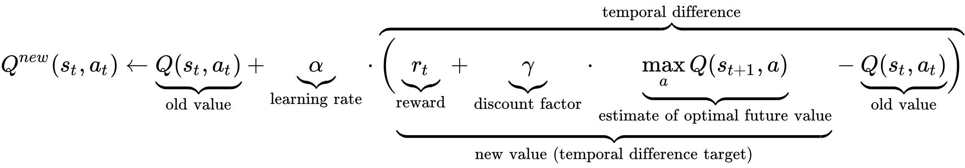
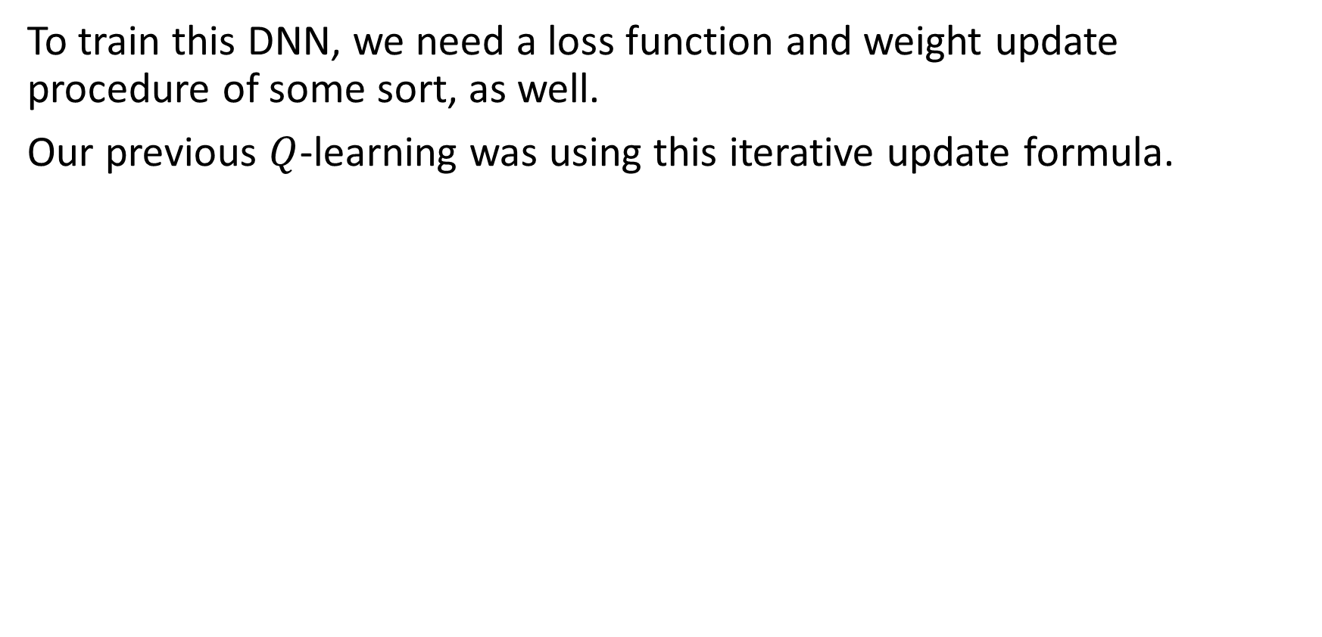
Toy example #3 (shown, but implementation out of the scope of this class)
To train this DNN, we need a loss function and weight update procedure of some sort, as well.
Our previous $Q$-learning was using this iterative update formula.

Slide 15
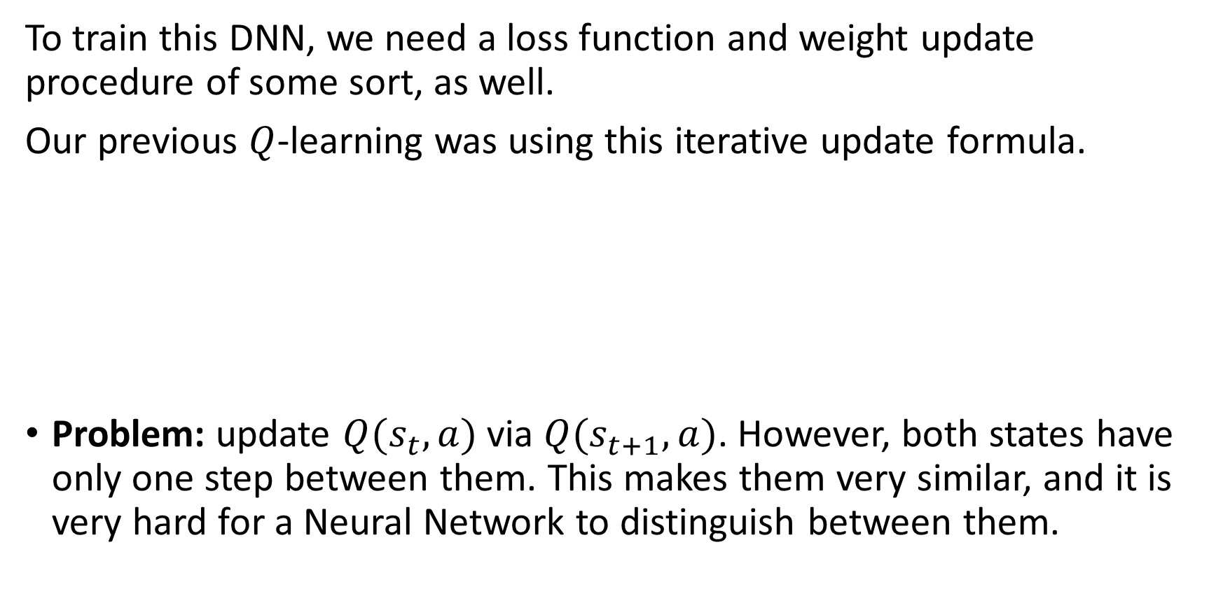
Toy example #3 (shown, but implementation out of the scope of this class)
To train this DNN, we need a loss function and weight update procedure of some sort, as well.
Our previous $Q$-learning was using this iterative update formula.
Problem: update $Q(s_{t}, a)$ via $Q(s_{t+1}, a)$. However, both states have only one step between them. This makes them very similar, and it is very hard for a Neural Network to distinguish between them.

Slide 16
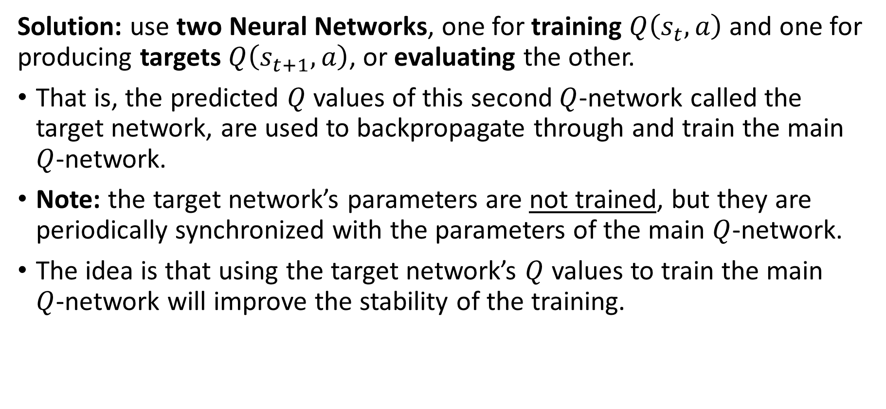
Toy example #3 (shown, but implementation out of the scope of this class)
Solution: use two Neural Networks, one for training $Q\left(s_{t}, a\right)$ and one for producing targets $Q\left(s_{t+1}, a\right)$, or evaluating the other.
That is, the predicted $Q$ values of this second $Q$-network called the target network, are used to backpropagate through and train the main $Q$-network.
Note: the target network’s parameters are not trained, but they are periodically synchronized with the parameters of the main $Q$-network.
The idea is that using the target network’s $Q$ values to train the main $Q$-network will improve the stability of the training.

Slide 17
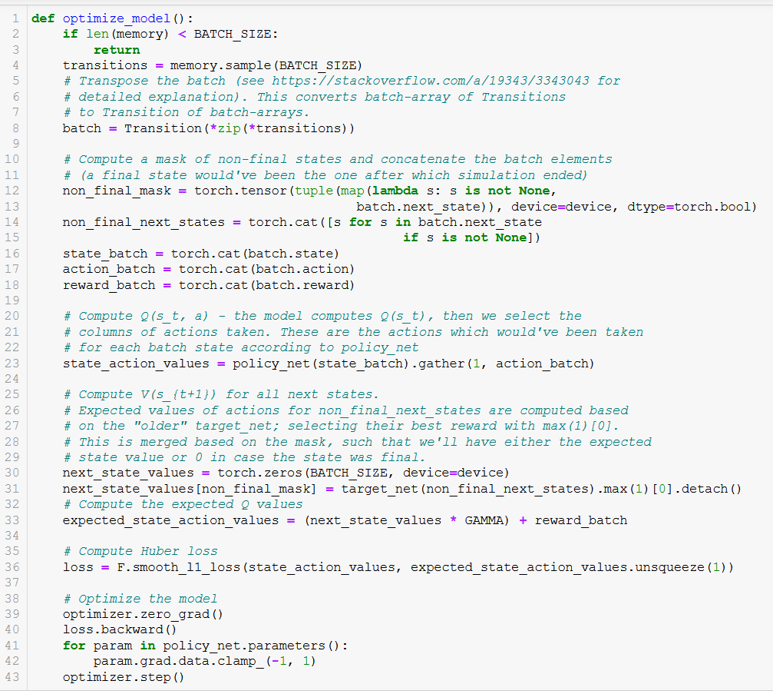

Slide 18
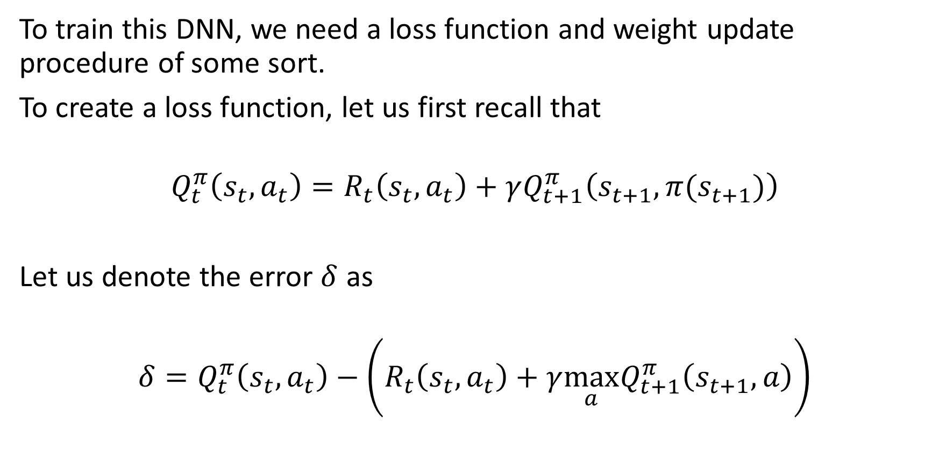
Toy example #3 (shown, but implementation out of the scope of this class)
To train this DNN, we need a loss function and weight update procedure of some sort.
To create a loss function, let us first recall that
$$Q_{t}^{π}\left(s_{t}, a_{t}\right)=R_{t}\left(s_{t},a_{t}\right)+γQ_{t+1}^{π}\left(s_{t+1},π(s_{t+1})\right)$$
Let us denote the error $δ$ as
$$δ=Q_{t}^{π}\left(s_{t}, a_{t}\right)−\left(R_{t}\left(s_{t},a_{t}\right)+γ{\max_{a}Q}_{t+1}^{π}\left(s_{t+1},a\right)\right)$$

Slide 19
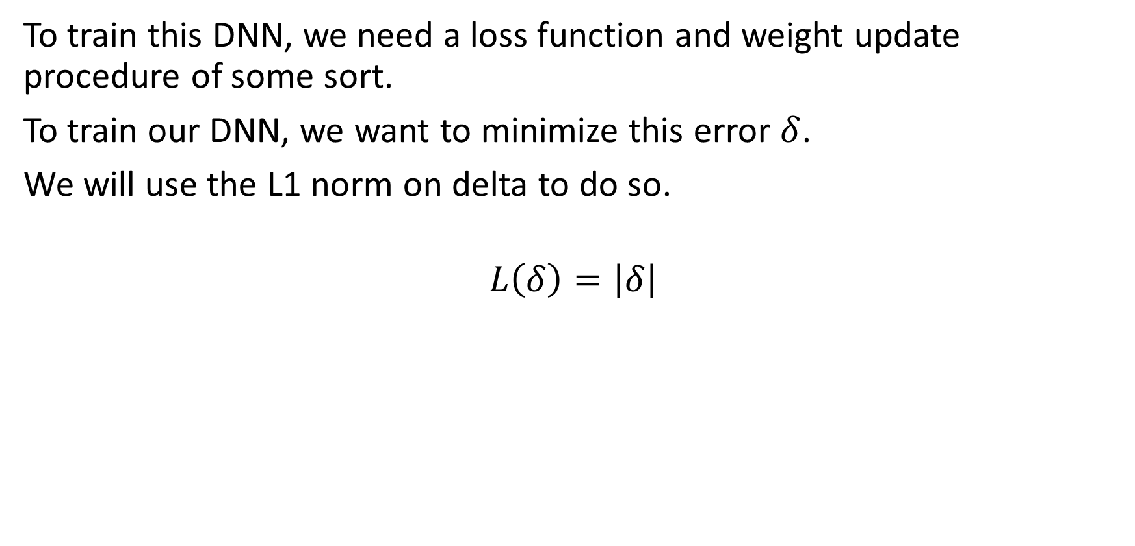
Toy example #3 (shown, but implementation out of the scope of this class)
To train this DNN, we need a loss function and weight update procedure of some sort.
To train our DNN, we want to minimize this error $δ$.
We will use the L1 norm on delta to do so.
$$L\left(δ\right)=\left|δ\right|$$

Slide 20
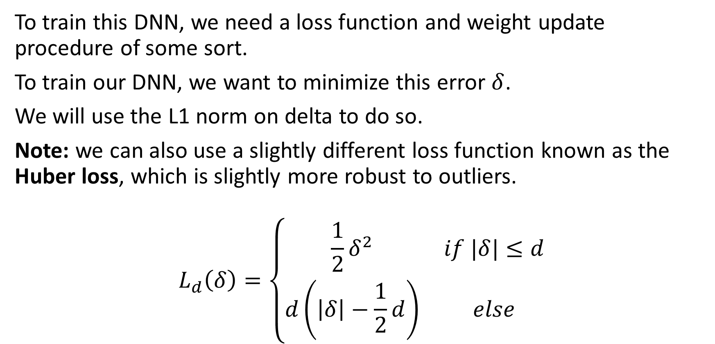
Toy example #3 (shown, but implementation out of the scope of this class)
To train this DNN, we need a loss function and weight update procedure of some sort.
To train our DNN, we want to minimize this error $δ$.
We will use the L1 norm on delta to do so.
Note: we can also use a slightly different loss function known as the Huber loss, which is slightly more robust to outliers.
$$L_{d}\left(δ\right)=\left\{\begin{matrix}\frac{1}{2}δ^{2} & if |δ|≤d \\ d\left(\left|δ\right|−\frac{1}{2}d\right) & else\end{matrix}\right.$$

Slide 22
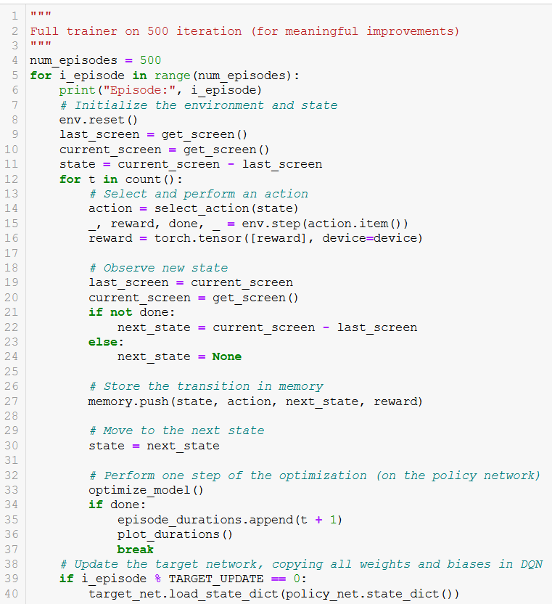
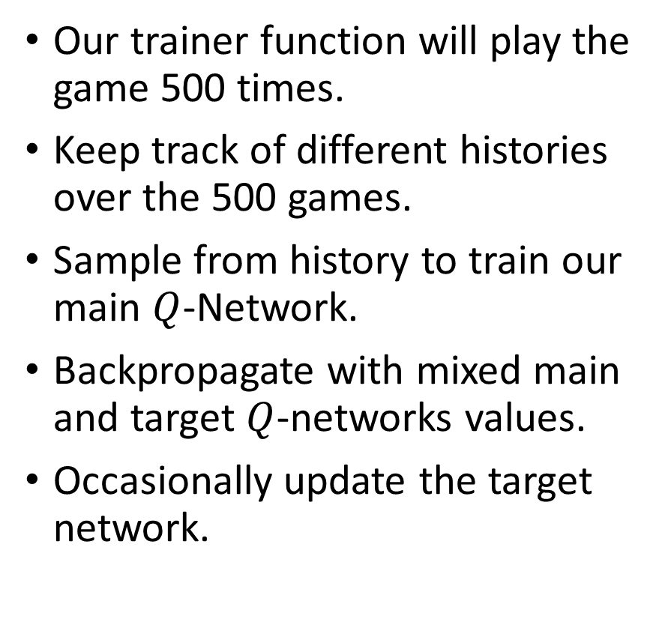
Trainer function
Our trainer function will play the game 500 times.
Keep track of different histories over the 500 games.
Sample from history to train our main $Q$-Network.
Backpropagate with mixed main and target $Q$-networks values.
Occasionally update the target network.

Slide 23
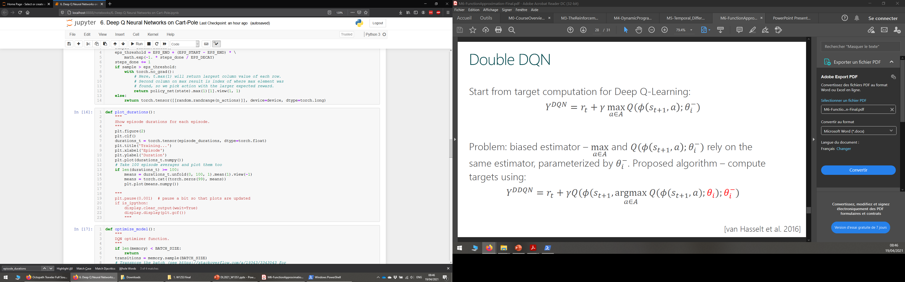
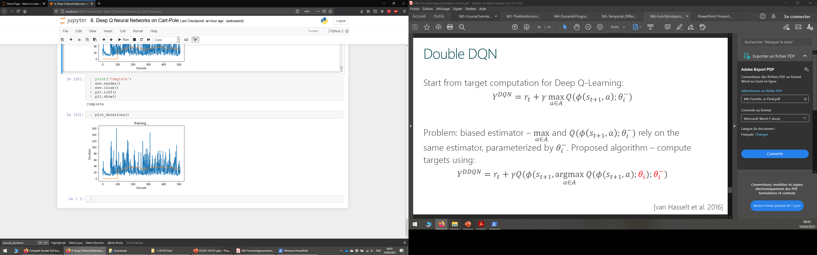
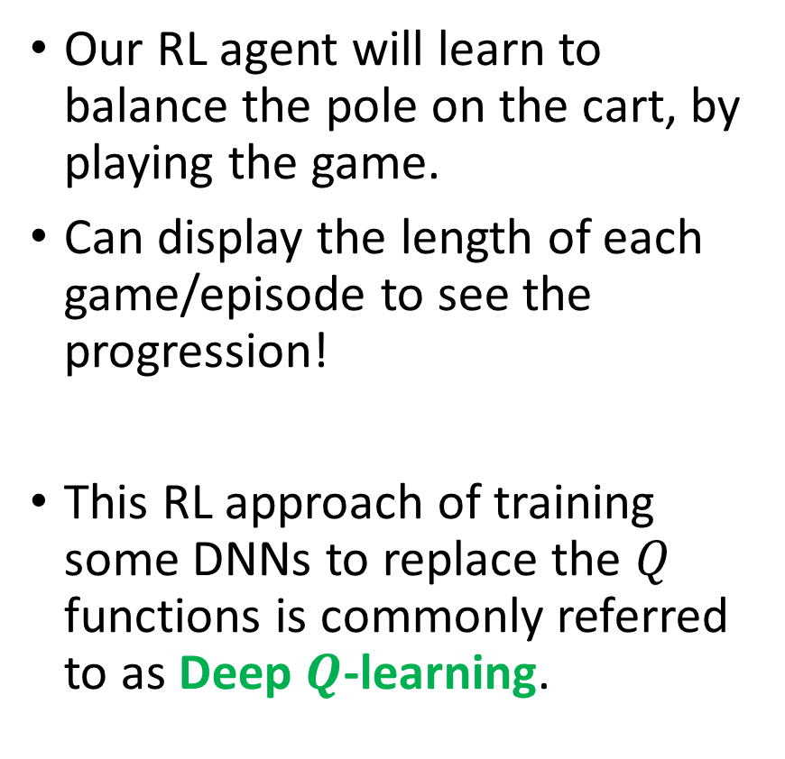
Training results
Our RL agent will learn to balance the pole on the cart, by playing the game.
Can display the length of each game/episode to see the progression!
This RL approach of training some DNNs to replace the $Q$ functions is commonly referred to as Deep $Q$-learning.

Slide 24
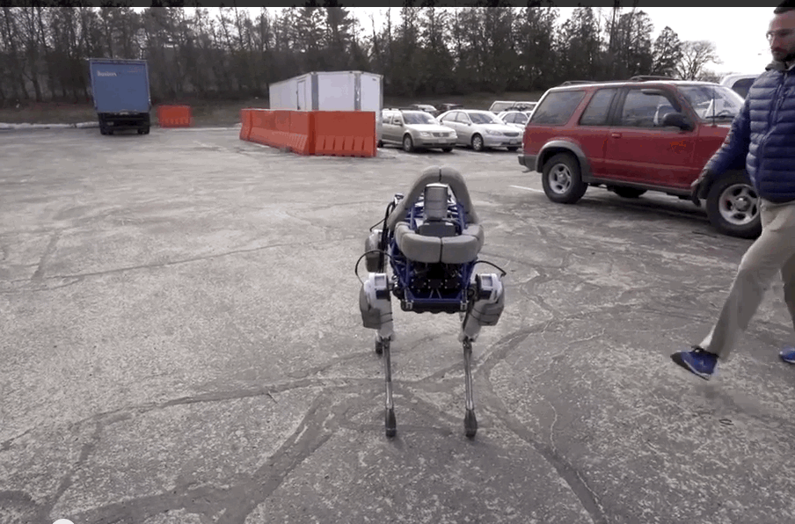
Following this cart-pole balance idea…
Train an AI to keep a robot on its feet, despite some “minor environment perturbations” (a polite way of saying you kick the hell out of the robot for fun).
Video: https://www.youtube.com/watch?v=NR32ULxbjYc
BostonDynamics blog: https://blog.bostondynamics.com/

Slide 25
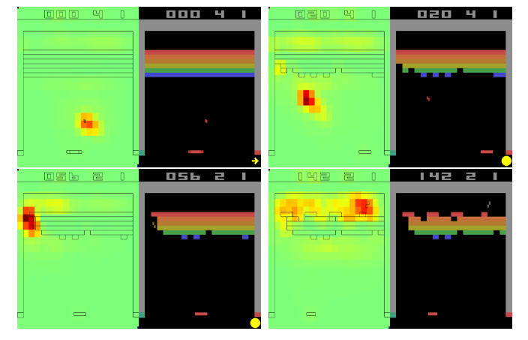
Following this idea of using computer vision to identify state and act…
Train an AI to play video games with Deep Reinforcement Learning (Mnih, 2013)!
Paper: https://www.cs.toronto.edu/~vmnih/docs/dqn.pdf
Video: https://www.youtube.com/watch?v=TmPfTpjtdgg

Slide 26
A quick word on actor-critic methods (more advanced stuff, out of scope)
In Deep Q-learning, we realized that most RL problems cannot have their Q functions computed easily.
We then replaced the Q function with a Deep Neural Network to approximate this function.

Slide 27
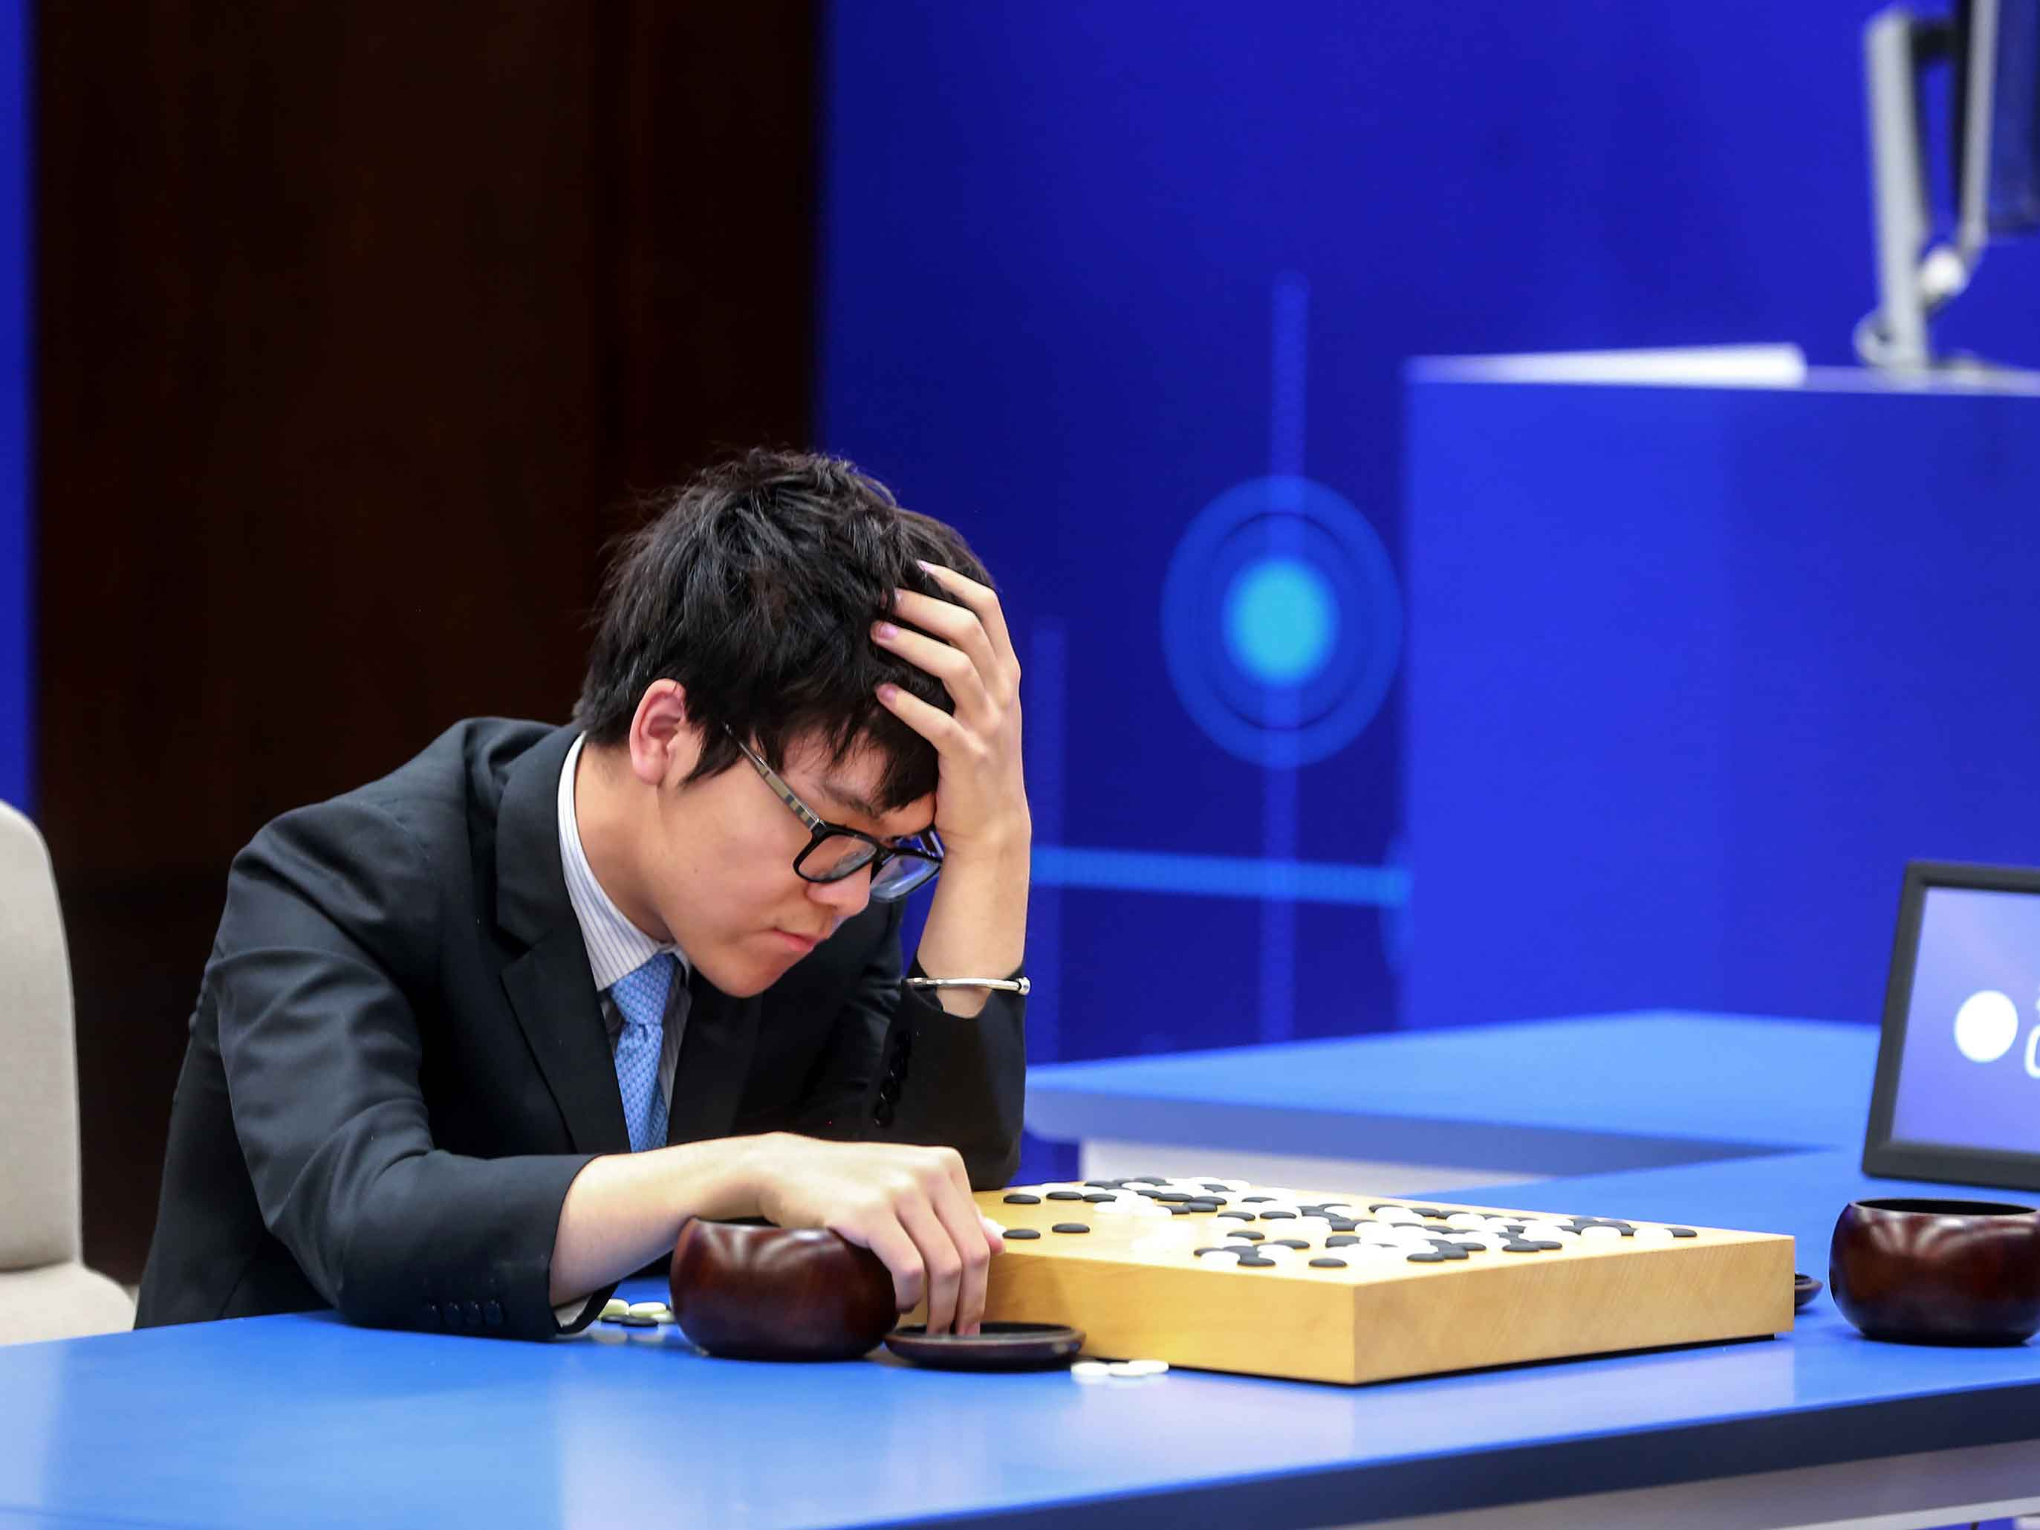
A quick word on actor-critic methods (more advanced stuff, out of scope)
In Deep Q-learning, we realized that most RL problems cannot have their Q functions computed easily.
We then replaced the Q function with a Deep Neural Network to approximate this function.
Additional suggestion: Can the reward function always be computed?

Slide 28
A quick word on actor-critic methods (more advanced stuff, out of scope)
In Deep Q-learning, we realized that most RL problems cannot have their Q functions computed easily.
We then replaced the Q function with a Deep Neural Network to approximate this function.
Additional suggestion: Can the reward function always be computed?
→ Replace more elements of the RL system with Deep Neural Networks.

Slide 29
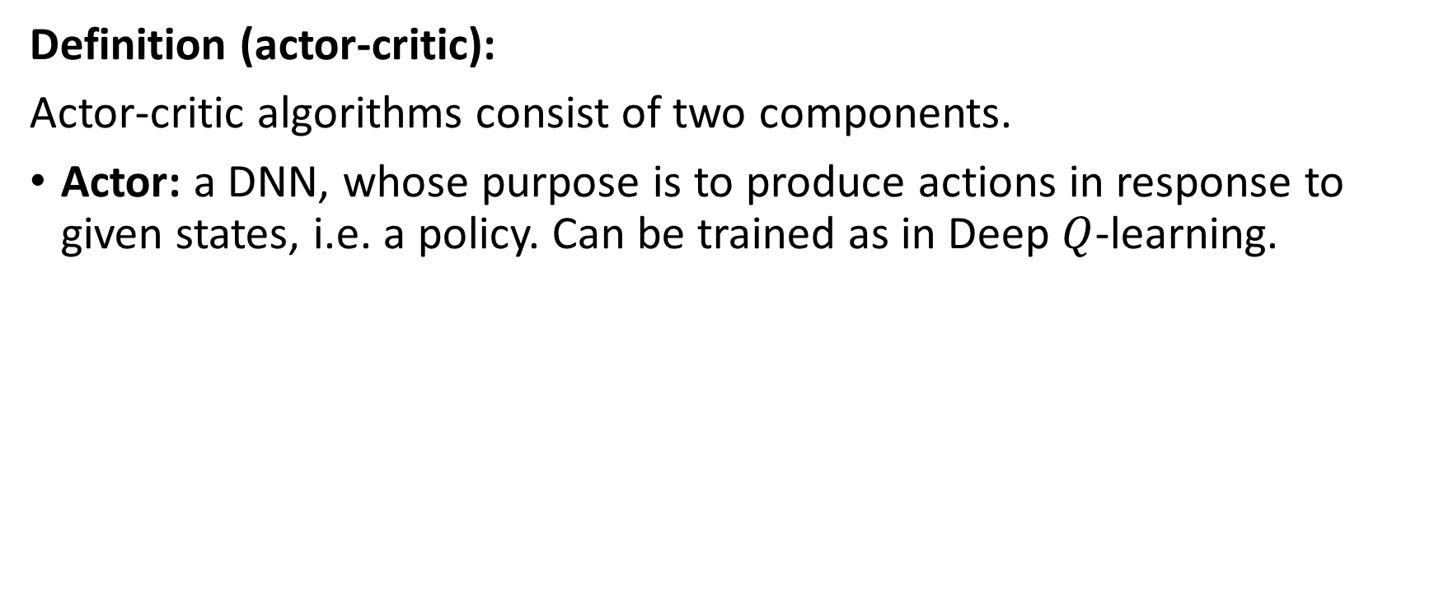
A quick word on actor-critic methods (more advanced stuff, out of scope)
Definition (actor-critic):
Actor-critic algorithms consist of two components.
Actor: a DNN, whose purpose is to produce actions in response to given states, i.e. a policy. Can be trained as in Deep $Q$-learning.

Slide 30
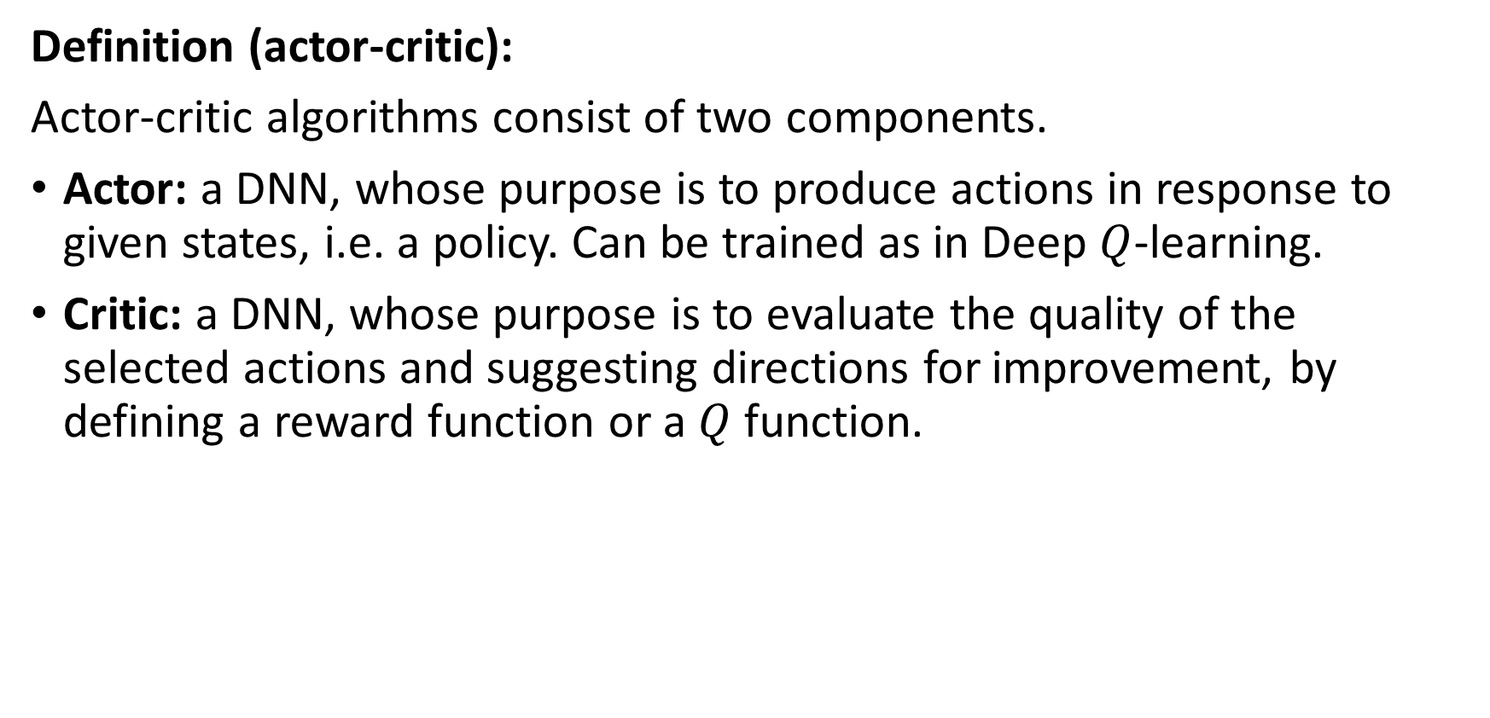
A quick word on actor-critic methods (more advanced stuff, out of scope)
Definition (actor-critic):
Actor-critic algorithms consist of two components.
Actor: a DNN, whose purpose is to produce actions in response to given states, i.e. a policy. Can be trained as in Deep $Q$-learning.
Critic: a DNN, whose purpose is to evaluate the quality of the selected actions and suggesting directions for improvement, by defining a reward function or a $Q$ function.

Slide 31
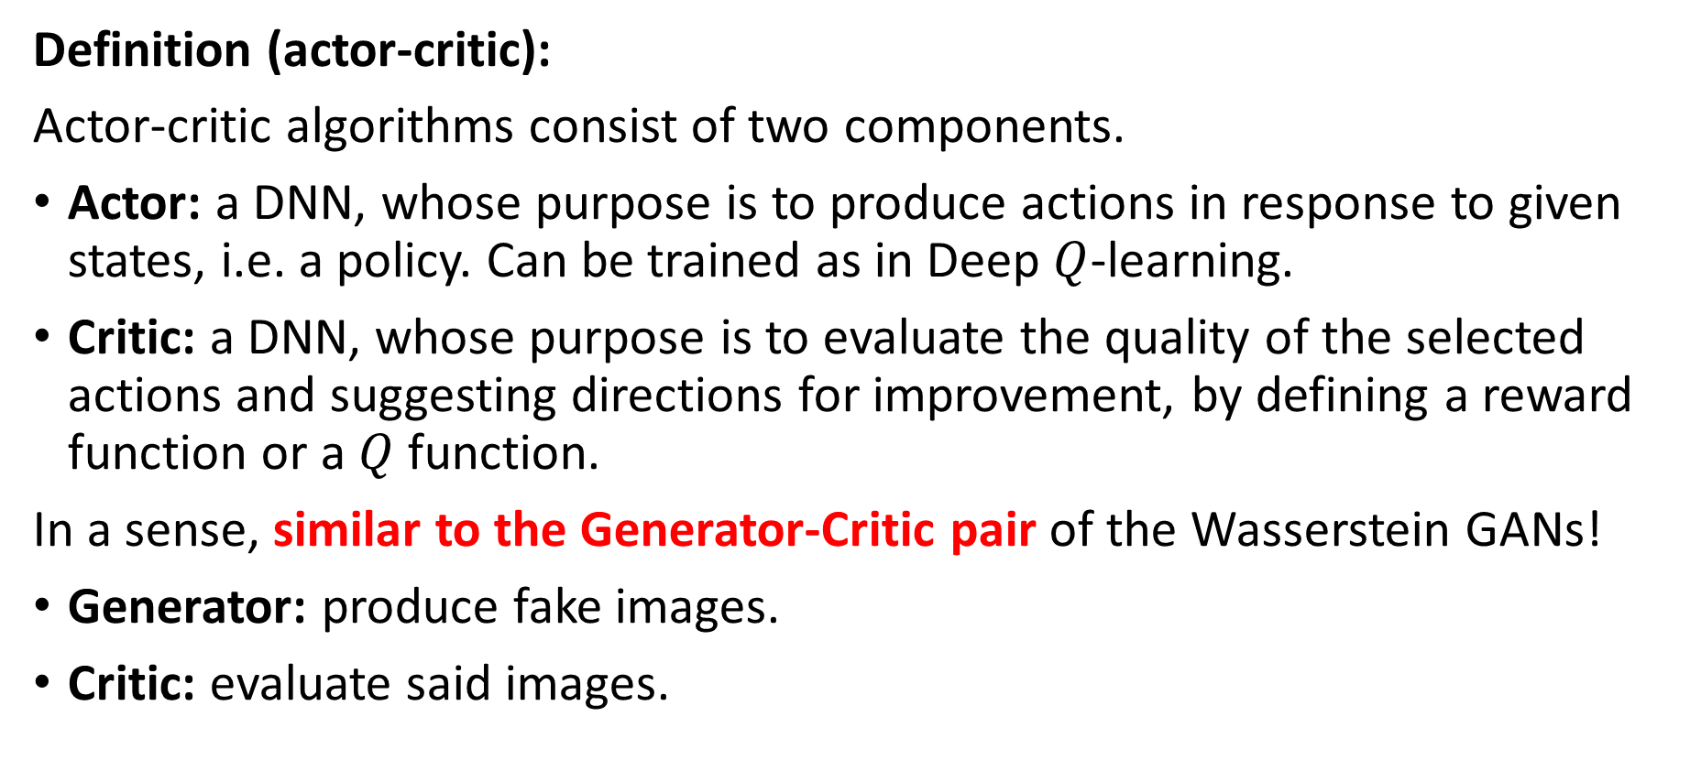
A quick word on actor-critic methods (more advanced stuff, out of scope)
Definition (actor-critic):
Actor-critic algorithms consist of two components.
Actor: a DNN, whose purpose is to produce actions in response to given states, i.e. a policy. Can be trained as in Deep $Q$-learning.
Critic: a DNN, whose purpose is to evaluate the quality of the selected actions and suggesting directions for improvement, by defining a reward function or a $Q$ function.
In a sense, similar to the Generator-Critic pair of the Wasserstein GANs!
Generator: produce fake images.
Critic: evaluate said images.

Slide 32
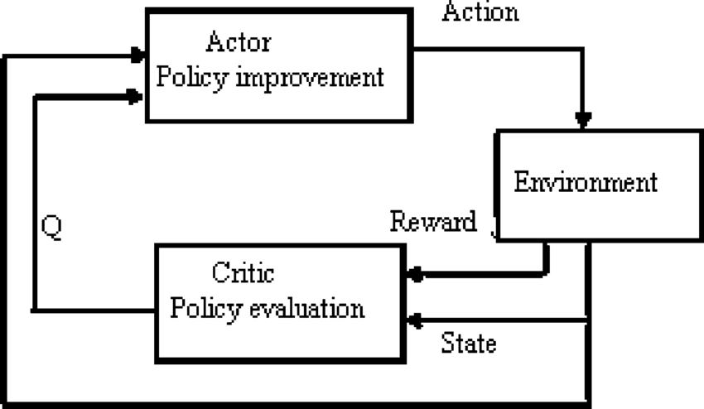
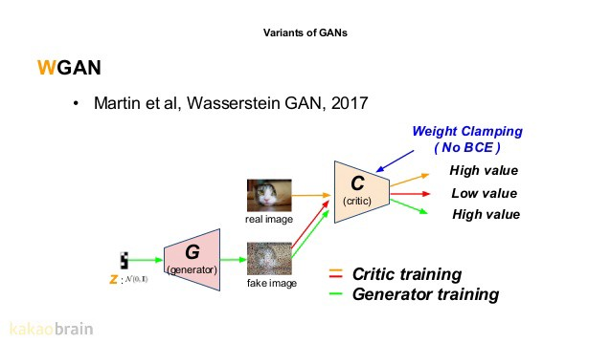
From Deep Q learning to actor-critic

Slide 33
RL with Human Feedback
Definition (Reinforcement Learning with Human Feedback):
Reinforcement Learning with Human Feedback (or RLHF) is a method in which an AI model (pre-trained or not), is typically represented as a reinforcement learning agent, and is fine-tuned/trained based on some feedback/reward provided by humans to improve its performance on a specific task.
This approach combines the strengths of reinforcement learning algorithms, which learn through trial and error, with the expertise and judgment of human evaluators.
The way ChatGPT was trained in fact!

Slide 34
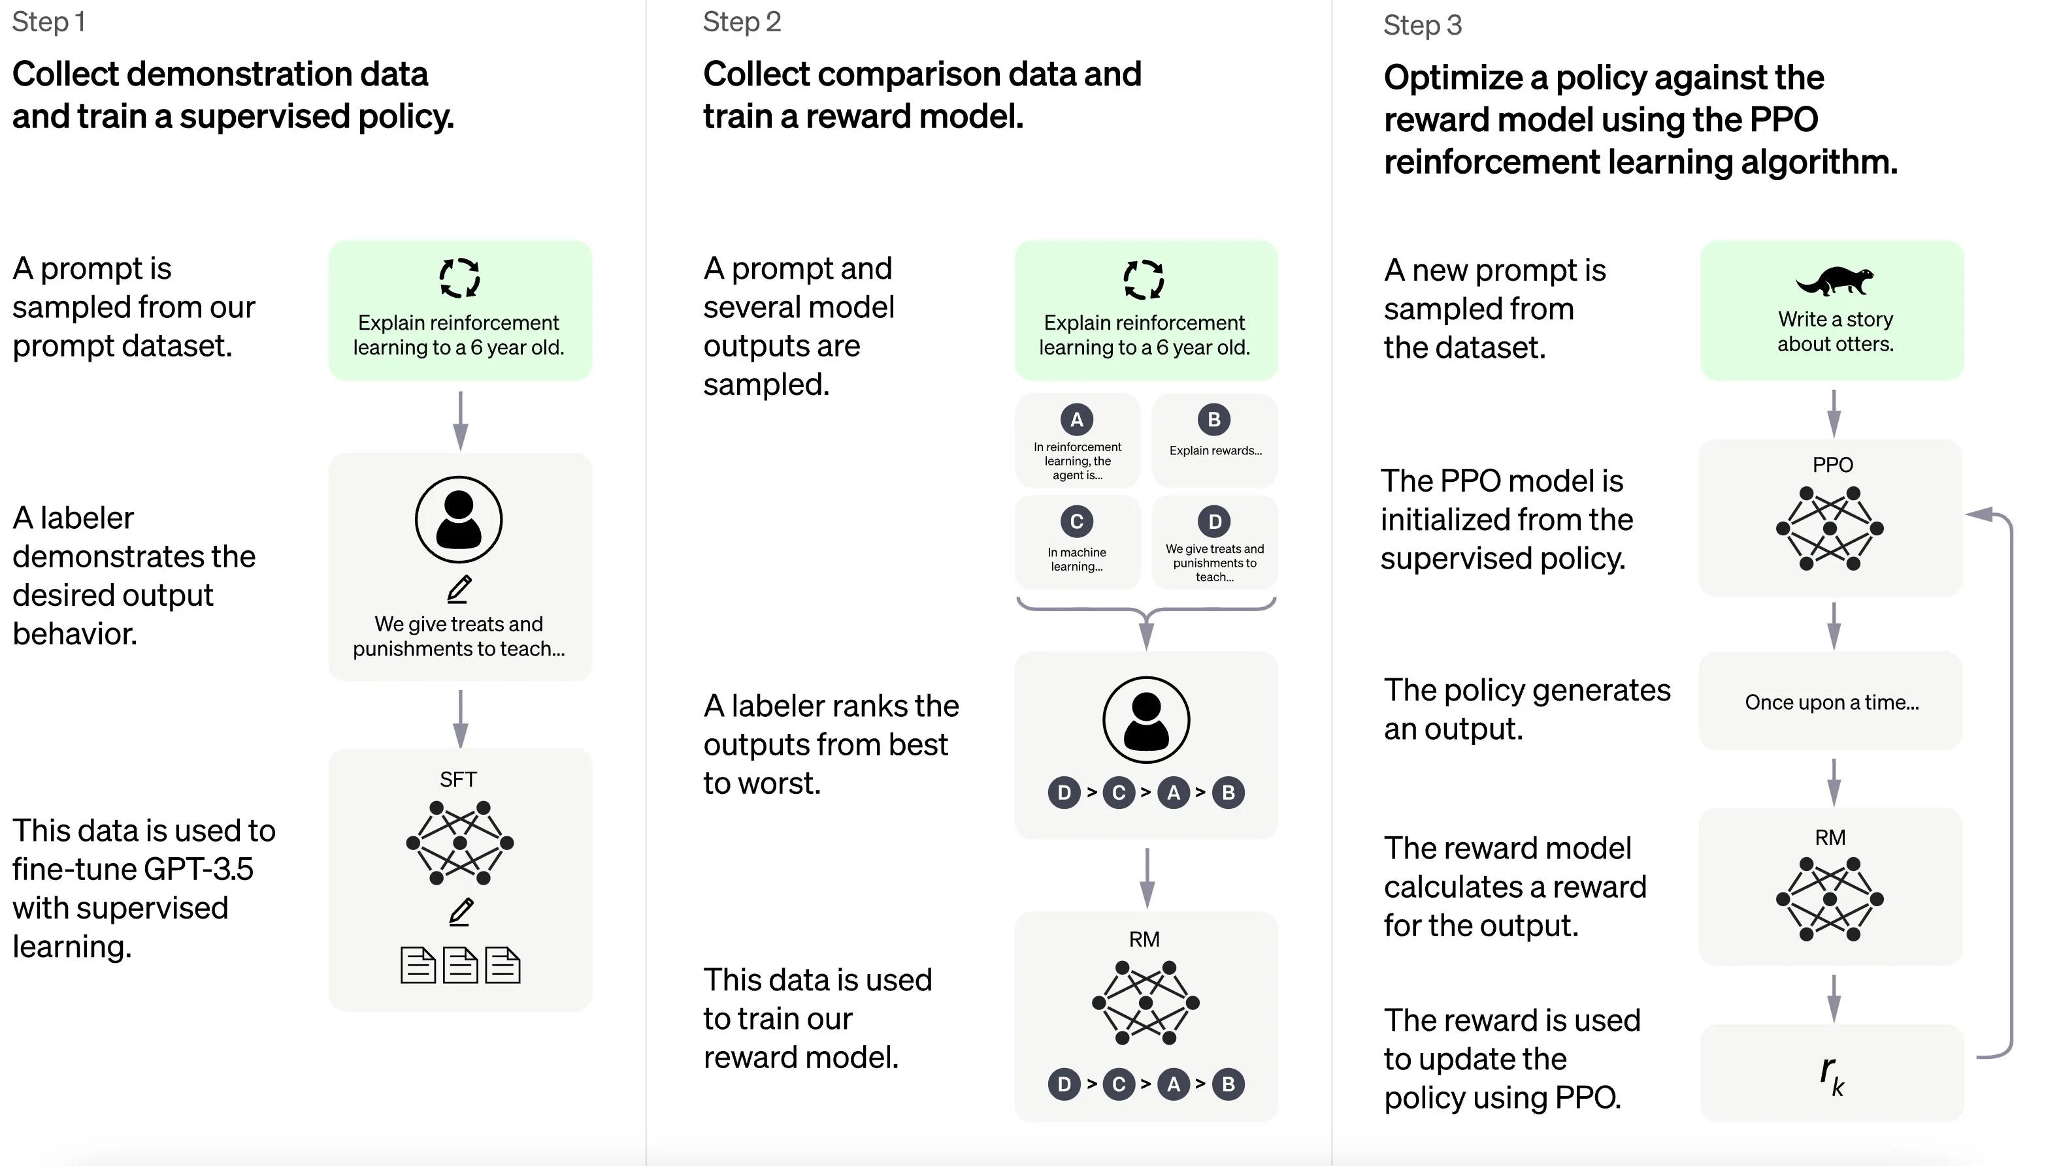
RL with Human Feedback
Definition (Reinforcement Learning with Human Feedback):
Reinforcement Learning with Human Feedback (or RLHF) is a method in which an AI model (pre-trained or not), is typically represented as a reinforcement learning agent, and is fine-tuned/trained based on some feedback/reward provided by humans to improve its performance on a specific task.
This approach combines the strengths of reinforcement learning algorithms, which learn through trial and error, with the expertise and judgment of human evaluators.
The way ChatGPT was trained in fact!

Slide 35
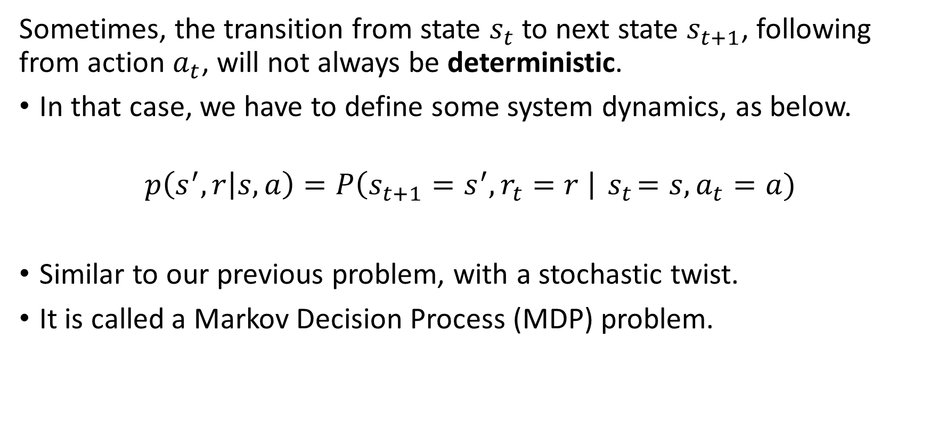
Markov Decision Processes (more advanced stuff, out of scope)
Sometimes, the transition from state $s_{t}$ to next state $s_{t+1}$, following from action $a_{t}$, will not always be deterministic.
In that case, we have to define some system dynamics, as below.
$$p\left(s^{′},r | s,a\right)=P\left(s_{t+1}=s^{′}, r_{t}=r \right|{ s}_{t}=s, a_{t}=a)$$
Similar to our previous problem, with a stochastic twist.
It is called a Markov Decision Process (MDP) problem.

Slide 36
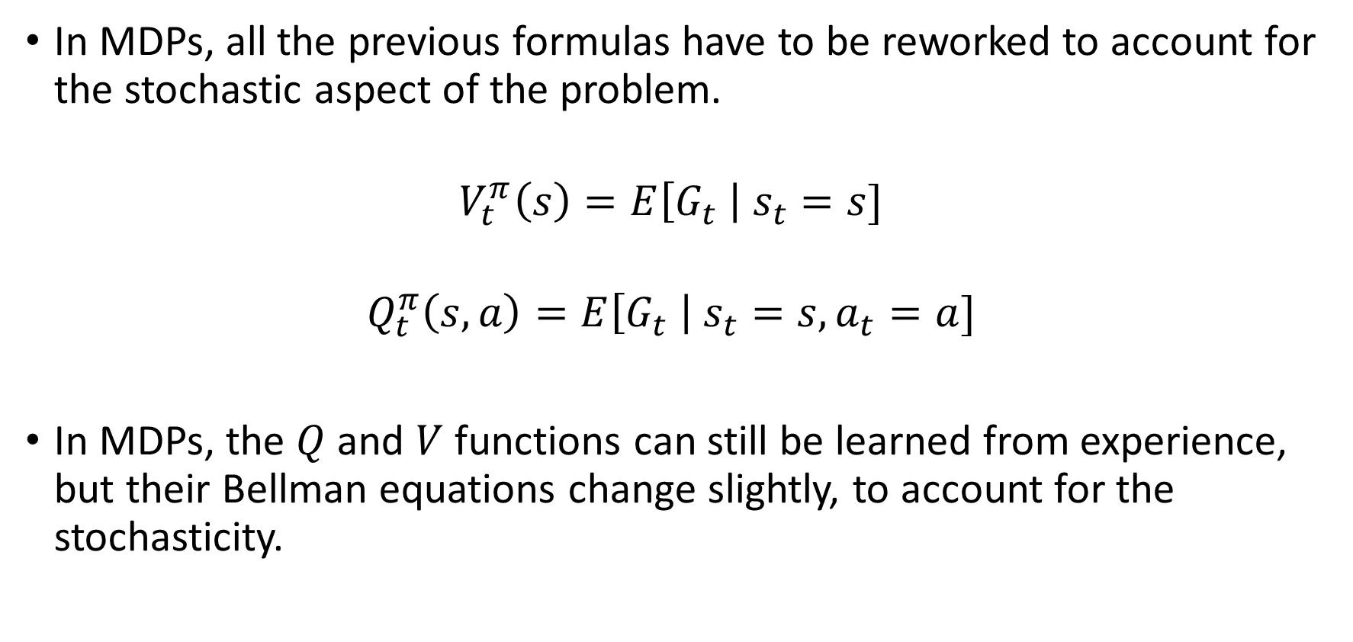
Markov Decision Processes (more advanced stuff, out of scope)
In MDPs, all the previous formulas have to be reworked to account for the stochastic aspect of the problem.
$$V_{t}^{π}\left(s\right)=E\left[G_{t} \right| s_{t}=s]$$
$$Q_{t}^{π}\left(s,a\right)=E\left[G_{t} \right| s_{t}=s, a_{t}=a]$$
In MDPs, the $Q$ and $V$ functions can still be learned from experience, but their Bellman equations change slightly, to account for the stochasticity.

Slide 37
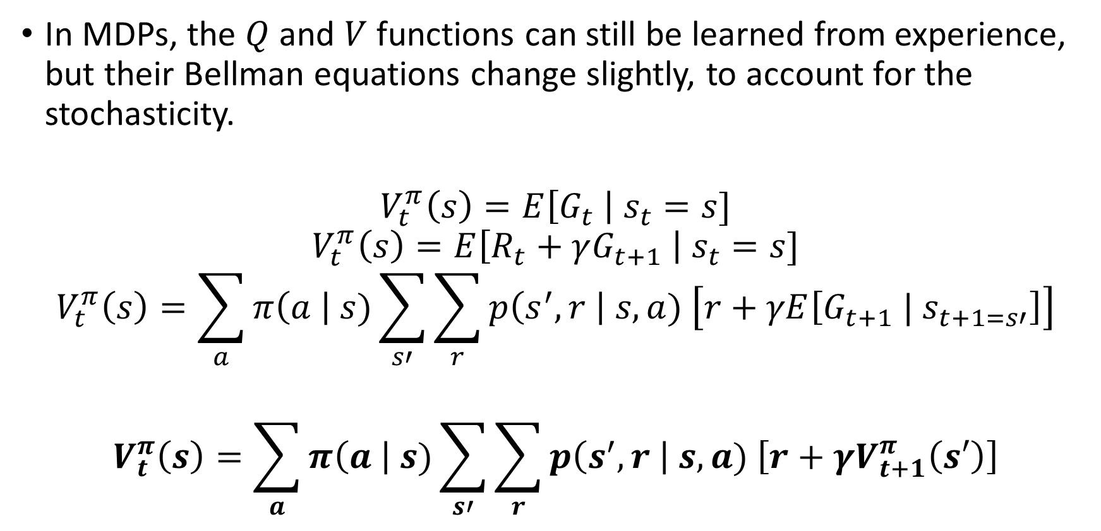
Markov Decision Processes (more advanced stuff, out of scope)
In MDPs, the $Q$ and $V$ functions can still be learned from experience, but their Bellman equations change slightly, to account for the stochasticity.
$$V_{t}^{π}\left(s\right)=E\left[G_{t} \right| s_{t}=s]$$
$$V_{t}^{π}\left(s\right)=E\left[R_{t}+γG_{t+1} \right| s_{t}=s]$$
$$V_{t}^{π}\left(s\right)=\sum_{a}{π\left(a \right| s)\sum_{s′}{\sum_{r}{p\left(s^{′}, r \right| s,a) \left[r+γE\left[G_{t+1} | s_{t+1=s′}\right]\right]}}}$$
$$V_{t}^{π}\left(s\right)=\sum_{a}{π\left(a \right| s)\sum_{s′}{\sum_{r}{p\left(s^{′}, r \right| s,a) \left[r+γV_{t+1}^{π}\left(s′\right)\right]}}}$$

Slide 38
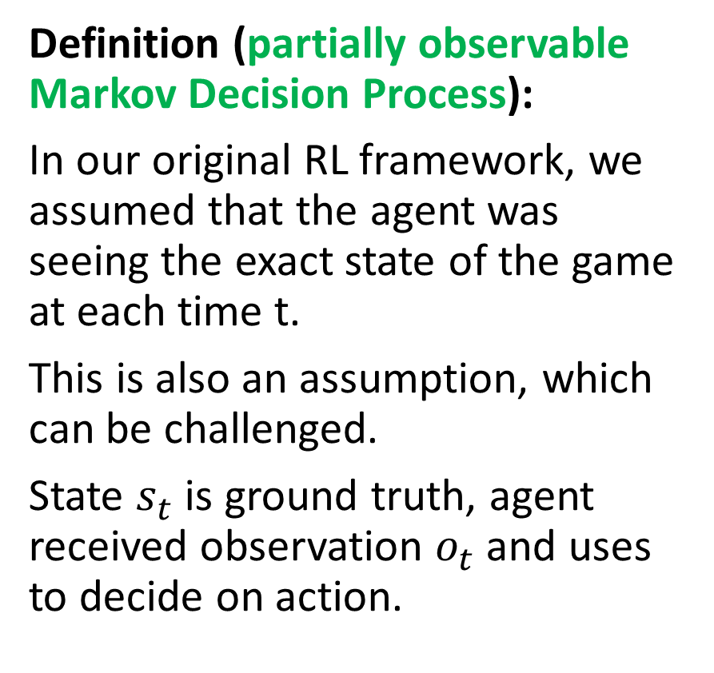
Partially observable MDP (more advanced stuff, out of scope)
Definition (partially observable Markov Decision Process):
In our original RL framework, we assumed that the agent was seeing the exact state of the game at each time t.
This is also an assumption, which can be challenged.
State $s_{t}$ is ground truth, agent received observation $o_{t}$ and uses to decide on action.
State
Take action based on observation
Reward is given for taking action in said state
Environment changes and a new state is produced
Observation is made by agent

Slide 39
Partially observable MDP (more advanced stuff, out of scope)
Definition (partially observable Markov Decision Process):
The agent then decides on an observation made of the actual (partially hidden) state.
This is called a partially observable Markov Decision Process.
Agent will have to learn to observe on top of acting properly (e.g. card game, with opponent hiding his/her hand).
State
Take action based on observation
Reward is given for taking action in said state
Environment changes and a new state is produced
Observation is made by agent

Slide 40
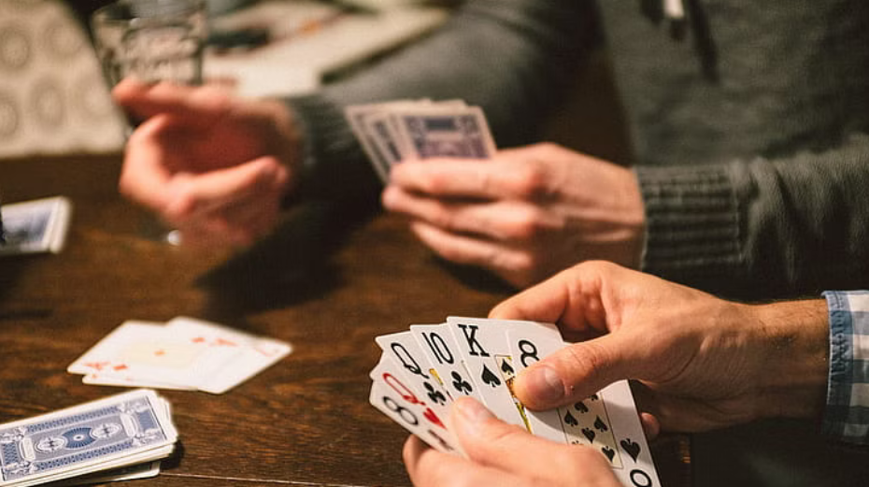
Partially observable MDP (more advanced stuff, out of scope)
Definition (partially observable Markov Decision Process):
The agent then decides on an observation made of the actual (partially hidden) state.
This is called a partially observable Markov Decision Process.
Agent will have to learn to observe on top of acting properly (e.g. card game, with opponent hiding his/her hand).
State
Take action based on observation
Reward is given for taking action in said state
Environment changes and a new state is produced
Observation is made by agent

Slide 41
State-Action-Reward-State-Action or SARSA (more advanced stuff, out of scope)
In many problems, e.g. Go, the new state seen by a given player is not the immediate result of the action of the said player.
Instead, another player has to act first, before a new state is produced.

Slide 42
State-Action-Reward-State-Action or SARSA (more advanced stuff, out of scope)
In many problems, e.g. Go, the new state seen by a given player is not the immediate result of the action of the said player.
Instead, another player has to act first, before a new state is produced.
This adds steps to the cycle, which becomes (state, action, reward, state_P2, action_P2).
Board state
P1 will take action based on state
Reward is given to P1 for taking action in said state
Environment changes and a new state is produced for P2
P2 will take action based on state
A new state will be produced for P1

Slide 43
State-Action-Reward-State-Action or SARSA (more advanced stuff, out of scope)
This is called a State-Action-Reward-State-Action (SARSA) type of problem.
In that case the agent has to learn how to play, but also has to learn how another player might respond to its actions.
RL meets game theory!
Board state
P1 will take action based on state
Reward is given to P1 for taking action in said state
Environment changes and a new state is produced for P2
P2 will take action based on state
A new state will be produced for P1

Slide 44
State-Action-Reward-State-Action or SARSA (more advanced stuff, out of scope)
This is called a State-Action-Reward-State-Action (SARSA) type of problem.
In that case the agent has to learn how to play, but also has to learn how another player might respond to its actions.
→ Train two AIs at the same time (one for black, one for whites)? Make them play against each other and train together like generator-critic in WGANs?
Board state
P1 will take action based on state
Reward is given to P1 for taking action in said state
Environment changes and a new state is produced for P2
P2 will take action based on state
A new state will be produced for P1

Slide 45
Conclusion
What are actor-critic learning methods? And which problems do these approaches address?
What are more advanced problems in RL?
Markov states
Partially observable environment
SARSA
Non-stationary problems
What is Reinforcement Learning with Human Feedback (RLHF)?

